Slide 1
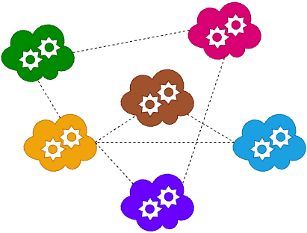
BINV3140-D Microservices
Lesson 6
2025-2026
Choquet Olivier
Miri Tarik
Strebelle Sébastien

Slide 2

Table of Content
Lesson’s Objective
Why Delivery Matters
Environments Definition
Continuous Integration
Continuous Deployment
Branching Strategies
Summary

Slide 3
1. Lesson’s Objectives
1
Understand the concept of delivery in microservices architecture
2
Recognise the role of environments
3
Explain the principles of Continuous Integration (CI) and Continuous Deployment (CD)
4
Understand what are branching strategies and how they influence deployments
5
Understand the importance of automation and quality checks

Slide 4
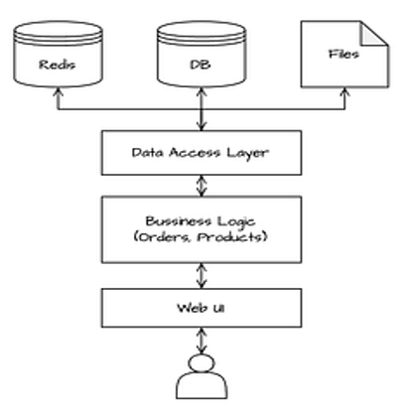
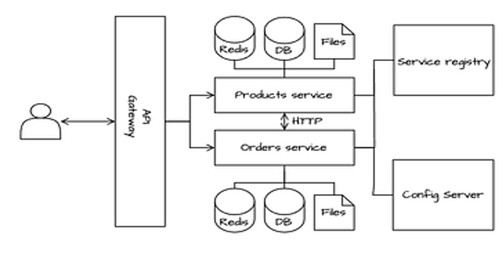




2. Why Delivery Matters
Monolith Architecture
Microservices Architecture
1 Team
1 Code Base
1 Pipeline
1 Application
Many Teams
Many Code Bases
Many Pipelines
Many Applications
Moving from monolithic to microservices delivery increases autonomy but also fragmentation, coordination, consistency, and observability become critical to maintain reliability across independent teams and pipelines.

Slide 5
3. Environments Definition
definition
An environment is a separate copy of the system where an application is deployed for a specific purpose, developing, testing, or running in production.
Environment Types
Why Multiple Environments?
1
Isolate Development from Production.
Developers constantly change code; they break things.
In a mono-environment set-up, one small mistake can make the entire system crash and impact users
Environment
Purpose
Who Uses It?
Typical Characteristic
DEV
Where developers write and test features.
Developers
Frequent code changes, unstable.
2
Enable Continuous Testing and Integration
When multiple developers work on microservices, changes from different teams need to be validated together.
Test environments integrate all microservices to detect compatibility or versioning issues.
Testing / QA
Used to run automated tests and integration checks.
QAs / Testers
Fake data, frequent resets.
3
STAGING / PREPROD / UAT
Replica of production for validation before release.
Developers + Operational Teams
Same configs as PROD.
Protect Real Data and Privacy
Production environments contain real user data, which is often confidential or regulated (e.g., GDPR.
Testing or experimenting directly there could expose sensitive information or accidentally delete data.
PRODUCTION
Live system used by real users.
End Users (Operational Teams)
Stable, monitored 24/7.
4
Support Continuous Delivery Culture
Multiple environments align perfectly with the CI/CD process:
CI ensures builds are tested automatically
CD promotes the builds through environments
Multiple environments aren’t bureaucracy; they’re safety nets. They protect users, safeguard data, and allow teams to innovate confidently.

Slide 6





4. Continuous Integration
definition
Continuous Integration (CI) is the practice of automatically building, testing, and analysing code whenever developers commit changes. The CI part of the delivery ensures the system remains reliable all the time.
Inside the CI Pipeline
1. Code Commit
2. Build
3. Testing
4. Quality Analysis
5. Artifact Storage
Developers push code changes to a shared repository (GitHub, GitLab, Bitbucket).
Each commit or merge triggers the CI pipeline automatically.
Dependencies are resolved (NuGet, npm, Maven, etc.).
Build scripts ensure the same process works everywhere — no manual steps.
Source code is compiled or packaged into an executable format (e.g., .jar, .dll, .zip).
Unit tests: check individual functions or classes.
Integration tests: verify interactions between components or services.
Regression tests: ensure new changes didn’t break existing features.
Automated static analysis tools inspect the code without executing it.
Detect potential bugs, security vulnerabilities, duplication, or complexity.
Measure test coverage, maintainability, and code smells.
Once validated, the build output (artifact) is versioned and stored in a central artifact repository.
Stored artifacts become the trusted input for deployment (CD) stages.
Enables rollback or reproduction of any previous build.
The goal of CI is confidence, automate everything so that developers can integrate often, fail fast, and recover quickly. Think of CI as a safety net — every time you push code, the system checks that nothing breaks before it reaches others.

Slide 7





5. Continuous Deployment
definition
Continuous Deployment (CD) is the practice of automatically delivering and releasing new software versions through multiple environments, from testing to production, without manual intervention. Every validated change from the CI pipeline can go live safely and consistently.
Inside the CD Pipeline
1. Deploy to Test
2. Quality Gates
3. Deploy to Staging
4. Deploy to Prod
5. Post-Deployment
The artifact produced by CI is deployed automatically to a test environment.
Automated integration, API, and UI tests run here.
Verifies that services interact correctly in a realistic environment.
The system checks that all tests and quality thresholds (e.g., performance, security, compliance) pass successfully.
Optional manual approvals may be required before promoting to the next stage
Staging mirrors production as closely as possible: same infra, configurations, and services.
Final tests (Load/performance tests, security scans, user acceptance).
Confirms readiness for production under real-world conditions.
The validated build is automatically rolled out to the production environment.
Deployment strategies ensure stability and minimal downtime (rolling updates, blue/green, canary releases)
Automated health checks and smoke tests confirm that services are running correctly.
If issues appear, the pipeline can trigger an automatic rollback to the previous version.
Continuous Deployment ensures that every validated change from development can reach users automatically, safely, and repeatedly, turning software delivery into a predictable, reliable flow instead of a risky event.

Slide 8
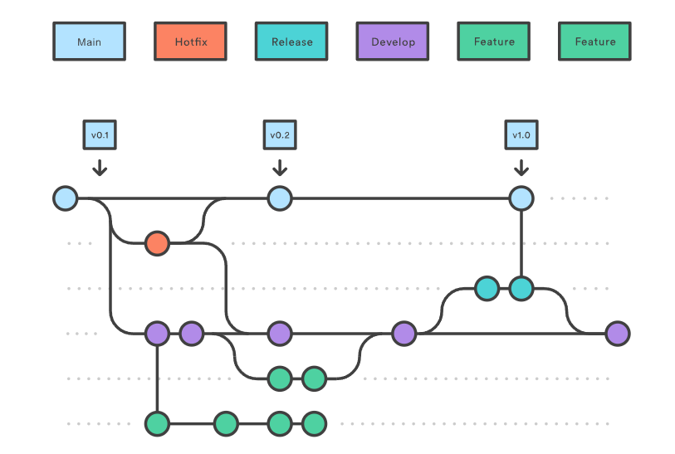
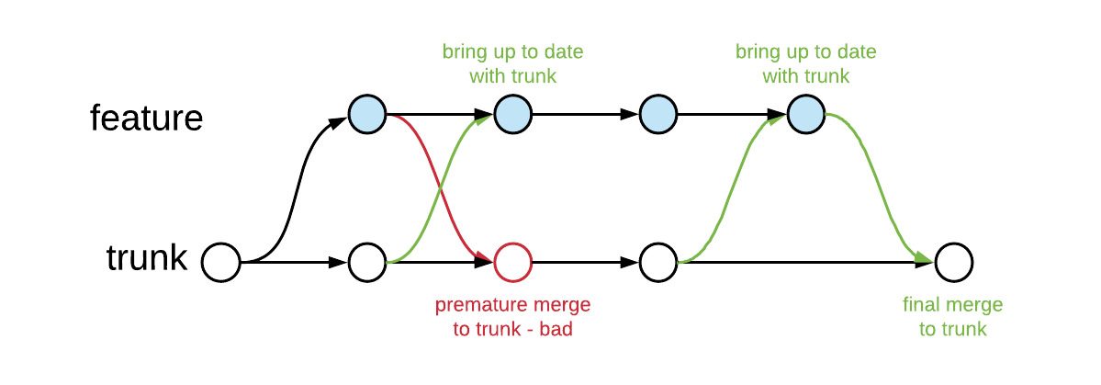

6. Branching Strategies
definition
A branching strategy defines how developers organise, isolate, and merge their code changes within a version control system (like Git).It determines how teams collaborate, how often they integrate, and how code moves from development to production.
Git Flow Workflow
Feature Branching
Trunk-Based Development
A structured workflow with multiple long-lived branches (main, develop, feature, release, hotfix). Ideal for teams with planned, versioned releases. Emphasizes control and stability over speed; every change goes through a clear path before production.
A collaborative approach where each new feature or bug fix is developed in its own branch. Changes are reviewed and tested through pull requests before being merged. Balances isolation with regular integration via CI pipelines.
A lean, modern workflow where developers commit small, frequent changes directly (or via short-lived branches) to the main branch. Every commit triggers the CI/CD pipeline, allowing for rapid, reliable releases.

Slide 9
6. Branching Strategies | Git Flow Workflow
Summary
Git Flow provides strong structure and control for teams managing planned releases, but its complexity can limit agility and continuous deployment.
Description
Pros
The project maintains two permanent branches:
main → stable production code.
develop → integration branch for ongoing development.
Structured and Predictable: Clear process for releases, features, and bug fixes.
Stable Production Branch: main always represents deployable code.
Supports Parallel Work: Multiple teams can work on different branches safely.
Flexible → easy to add new consumers.
Version Control Discipline: Tags and merges create a transparent release history.
Each new feature or bug fix is developed in a dedicated feature/ or bug/ branch.
Developers work independently until the feature is complete.
When a set of features is ready for deployment, a release/ branch is created from develop.
Cons
Heavy Workflow: Too many branches → slower integration and delivery.
High Merge Overhead: Frequent merge operations increase maintenance.
Complex for Small Teams: Overkill for fast-moving or microservice-based environments.
Although still broadly used, this workflow is considered to be legacy due to its complexity.
The release branch is merged into main and tagged with a version number (v1.0).
It is also merged back into develop to synchronize post-release changes.
If a critical issue appears in production, a hotfix/ branch is created from main.
Once fixed, it’s merged into both main and develop to keep them aligned.

Slide 10
6. Branching Strategies | Feature Branching
Summary
Feature Branching provides safety and clarity through isolation, but only works efficiently when branches are short-lived and integration is frequent.
Description
Pros
Developers create a new branch for each new feature, bug fix, or enhancement.
Convention: feature/feature-name (e.g. feature/login-page).
Isolation: Each feature is independent — minimal risk of breaking the main code.
Supports Code Review: Pull requests encourage collaboration and knowledge sharing.
CI Integration: Each branch can trigger automated build/test pipelines.
Simple and Intuitive: Easy to understand for new developers.
Work happens in isolation; developers can commit and test changes freely.
The feature branch is regularly synced with main or develop to stay up to date.
When the feature is complete, the branch is pushed to the shared repository.
A Pull Request (PR) is created for peer review
Cons
Merge Conflicts: If branches live too long, integration can be painful.
Delayed Integration: Risk of “big bang” merges if developers don’t rebase often.
Slower Feedback: Issues discovered late in the merge process.
Requires Discipline: Teams must commit and merge frequently to avoid drift.
Code is reviewed, discussed, and approved by peers.
CI tests must pass before merging into main or develop. After merge, the feature branch is deleted to keep the repo clean.
Some teams use CI/CD pipelines to deploy every merged branch automatically to a staging or test environment for validation.

Slide 11
6. Branching Strategies | Trunk-Based Development
Summary
Trunk-Based Development is the foundation of modern DevOps: fast, collaborative, and automation-driven, but demanding strong discipline and reliable testing.
Description
Pros
The repository maintains one main branch, often called main or master.
All production-ready code lives here.
There are no long-lived feature branches.
True Continuous Integration: Every commit is validated and integrated immediately.
Fast Delivery: Enables real-time deployment and quick feedback.
Reduced Merge Conflicts: Frequent merges mean fewer integration headaches.
Simple Branching Model: Minimal Git complexity; easy to visualize and manage.
Developers may create a temporary branch for a small change.
These branches live for only a few hours or a day, and are merged back quickly.
Everyone commits directly (or merges) into main multiple times a day.
Each commit triggers the CI pipeline.
Any failed build stops further merges until fixed.
Cons
Requires Strong CI/CD: Must have reliable automated builds and tests to prevent breakage.
Higher Discipline Needed: Poor commits can break the main branch quickly.
Feature Toggles Add Complexity: Managing flags and toggled code paths can become messy.
Less Isolation: Riskier for experimental or long-running features.
Unfinished features are hidden behind feature flags/toggles.
Code can be merged safely even if not yet user-facing. This avoids long-running branches while keeping production stable.
Successful builds can automatically deploy to staging or production through CD pipelines. The system stays always in a deployable state.

Slide 12



6. Branching Strategies | Comparison
Git Flow Workflow
Feature Branching
Trunk-Based Development
Integration Frequency
Low: code integrated only after full features or releases.
Medium: code merged after each completed feature.
High: frequent, small integrations multiple times per day.
Branch Lifespan
Long: weeks or months for develop/release branches.
Short: branches last a few days.
Very short: hours or direct commits to main.
Complexity
High: many branches, frequent merges, overhead.
Moderate: manageable structure, some merge coordination.
Low: minimal branching, simpler process, relies on automation
Team Coordination
Structured: clear ownership but slower collaboration.
Collaborative: teams work independently with regular reviews.
Highly collaborative: constant communication, shared ownership.
Typical Use Case
Enterprise projects: planned releases, multiple versions.
Standard CI teams: regular feature delivery and reviews.
DevOps / Microservices: continuous integration and deployment.
From structured and stable (Git Flow) to collaborative (Feature Branching) and finally continuous (Trunk-Based) — each strategy suits a different level of automation and team maturity.

Slide 13
9. Summary
1
Delivery is a Core Part of Modern Software Engineering
2
Environments Enable Safe Progression
3
CI/CD Pipelines Automate the Path to Production
4
Branching Strategies Shape Collaboration and Delivery Speed

